Slide 1
Massachusetts Community Colleges & Workforce Development m Transformation Agenda
Transformation Agenda Summer Gathering
August 20, 2014 Using & Sharing Data for Student Success Session 1E & 2E – Salon ABC
This work is licensed under a Creative Commons 3.0 License http://creativecommons.org/licenses/by/3.0
This workforce solution is 100% funded by a grant awarded by the U.S. Department of Labor, Employment and Training Administration, TAACCCT grant agreement # TC-22505-11-60-A-25.The solution was created by the grantee and does not necessarily reflect the official position of the U.S. Department of Labor. The Department of Labor makes no guarantees, warranties, or assurances of any kind, express or implied, with respect to such information, including any information on linked sites and including, but not limited to, accuracy of the information or its completeness, timeliness, usefulness, adequacy, continued availability, or ownership. Massachusetts Community Colleges are equal opportunity employers. Adaptive equipment available upon request for persons with disabilities.

Slide 2
Data Bus Proof of Concept
Briefing and Demonstration
Jeff Merriman, (Norm Wright)
August 20th

Slide 3
Data Bus POC Presentation
Overview and Demonstration
Review the status of the project
Next Steps

Slide 4
Bus Architecture Overview
College 1
Career Center 1
DHE
Real Time Data Exchange
Data Bus
College 2
DCS
College 3
Career Center 2

Slide 5
Bus Architecture Detail
Local Data Systems
Gateway
Local Integration Adapters
Access Control
Data Bus

Slide 6
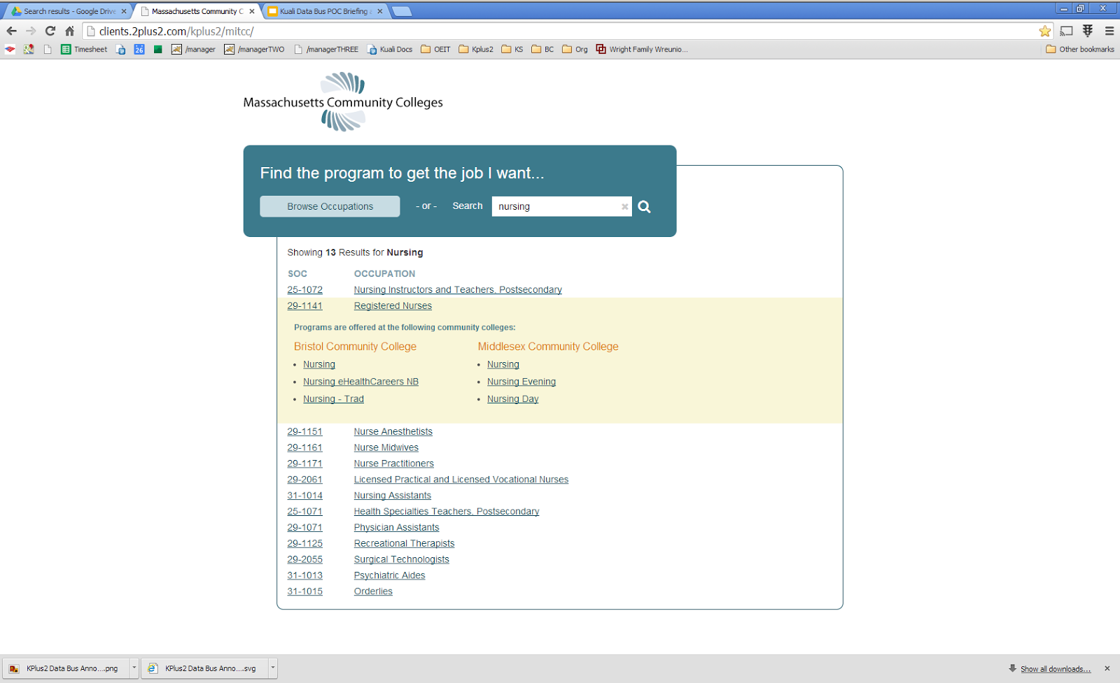
Demo Site

Slide 7
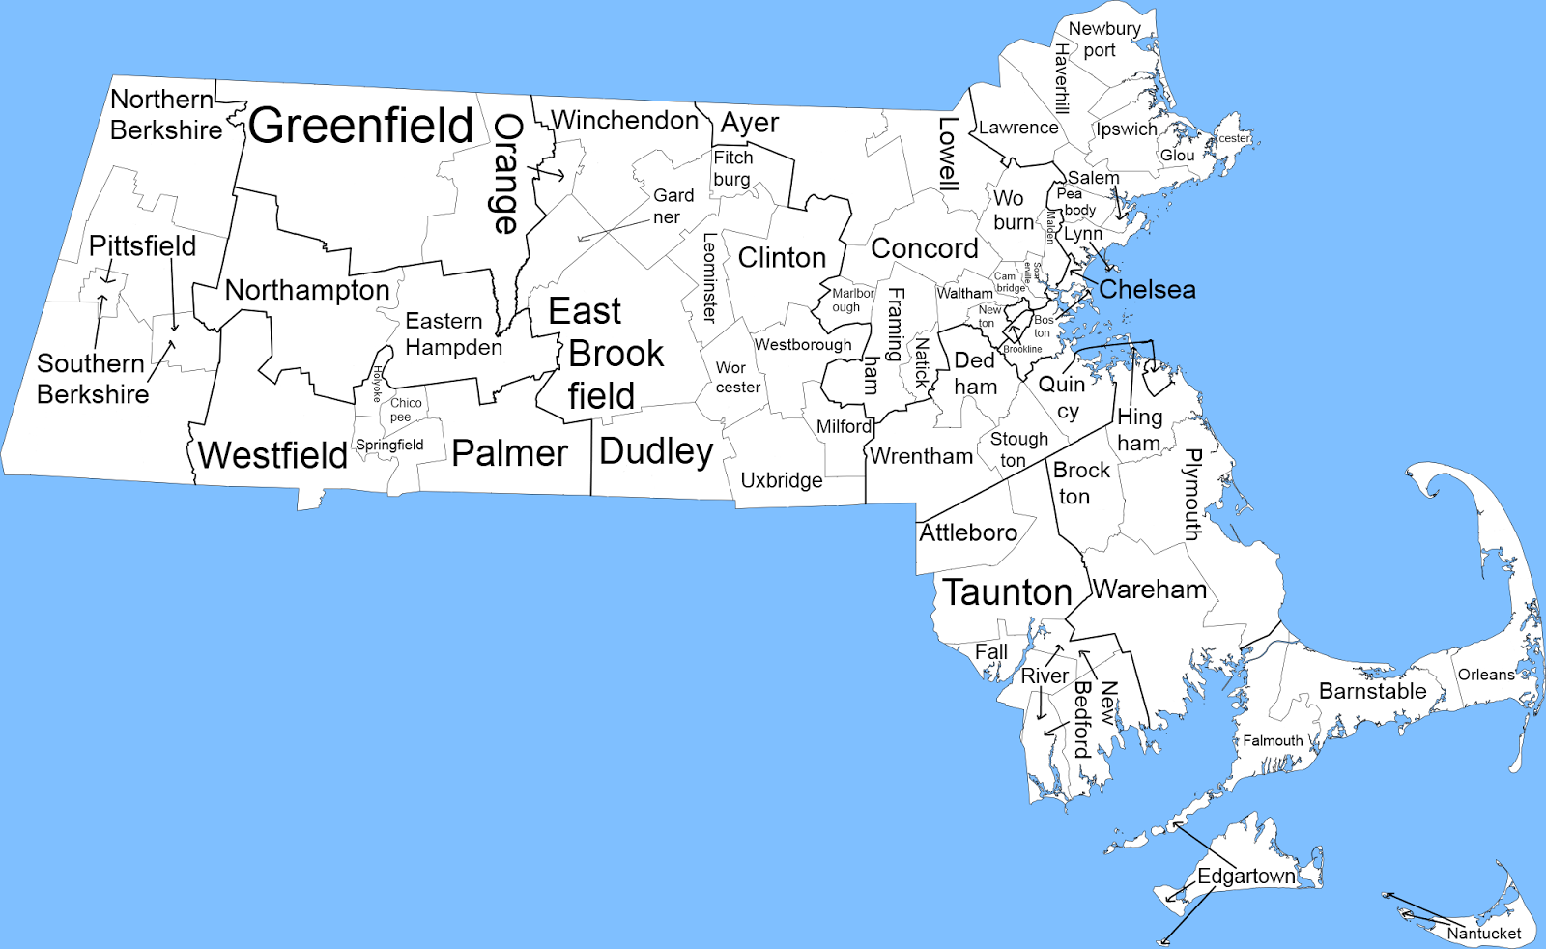
What’s happening
MCC
UI
Bus
BCC

Slide 8
What has been accomplished?
Business/Organizational
Working with CC’s & Career Centers
Opportunities identified
TAACCCT Round IV submitted
Technical
Infrastructure/ Authz
Local Control of Gateway
Banner adapter
Artifacts
Planning Phase Report
Data Bus Architecture
Open Source Code

Slide 9
Next Steps
HEIRS and Wage integration POC
Proof of Concept in development
User Input Sessions (September?)
TAACCCT Round 4 (waiting)
Productize POC
Extend to more CCs, involve DCS, DHE

